Slide 1
Strain gauge registrations =>
Secured Scale Controller =>
Scale Crypto Network Project
ArcelorMittal Ktiviy Rig
Automation department
April 2015

Slide 2
Excising scale systems contains a lot of possibilities for manipulation of weighting results
Software issues:
- typical scale system contains not only chain “sensor => scale controller => ERP system”, but some amount of additional software, like scale calibration utilities, scale controller drivers, special automated workplaces, intermediate databases. All additional software have the ability to impact weighting results – so existence if this items are security leaks.
“Password” mistake:
- typical scale system have some “password” protected items – and the “password” usually is an everybody known word. In case, when somebody keep password secure – he become the point of pressure. “Password” protection approach – is an security leak by itself – it provides no guaranteed authentication, it cannot be used for encrypt protection. It’s a ”stick in the wheels”.
Signal lines openness:
Most of the signal channels are unprotected and give the ability to send fake signals.
Physical openness:
- Because of signal lines openness any item of the scale system can be replaced by it’s fake hardware emulator or its work can be compromised by direct physical influence.
List above is not full list of security leakages – but it is full enough to say that we need to review the requirements – to which typical scale system must satisfy. It is possible for now to create fully independent from human factor and secure system – there are an examples of such systems already working.

Slide 3
To avoid any chance of compromising the weighing data, scale system must satisfy following requirements:
It must be solution “in the box”. Today we know a lot about intellectual sensors, - so there is no obstacles for creating solution, which consists of a single unit – needed sensors, controllers, database as one device – which “communicate” to other agents in the network by secure channels. The consequences of this are:
  Weight fact registration must be divided from workflow processing. They must be linked – but not the same. Weight box doesn’t contain database of transport numbers, tare and all other things, needed to perform goods flow.
  “Boxed” solution must be filly protected – not only in “virtual” software meaning, but physically also, this must be single metallic locked box with no external connectors except power and network connections.
This device acts as an locked secured agent – which is independent from other agents in the network. This requirement means decentralized scale system – like peer-to-peer network. Such architecture gives us no point for pressure – in attempt for manipulating data. There is no central point – so if you want to hack – you need to hack the whole network. Big amount of agents make this task very expensive.
Modern cryptographic technics make possible to guarantee authentication and integrity of data by using digital signatures and recursive hashes. There are good examples of such technology – crypto-currency networks.
Basic idea to format requirements to the scale system is that we can’t leave the ability to influence of human factor. Fully automated system must be able to provide all transactions, including maintenance and calibration.

Slide 4
Hardware design be based on any vendor of typical electronic components – there is no arguments to make preferences to somebody.
Additional sensors needed to detect “compromising” situations and disqualify Scale Box in the network.
“Box Open Endpoints” needed – if somebody opens the box it must be requalified – injections are possible.
Vibration, Accelerometer, GPS sensors are needed to fix place of weighing fact and stability of measured weight.
Any hitting must be detected by accelerometer and vibration sensor – they are also disqualify Scale Box.
Controller must be placed internally and contain all software logic to make Scale Box as agent into Crypto network.
t
Box Open
endpoint
Vibration
Strain gauge
Accelerometer
Controller
GPS
Network connection can be any suitable way to bring to the Internet – crypto network is working only with periodical connection to peers. Device configuration panel must support 802.1x certificate authorization.
Internal power can be used with mobile scale boxes – accumulators must be placed in separate part from main box.
Hardware design can be done on basis of ordinary PC with IO boards, on basis of single board controller, any other decision which can support software and network requirements.

Slide 5
Software solution can be copied from Bitcoin technology.
Decentralized distributed cryptographic peer-to-peer network – Bitcoin crypto currency – can be an example of suitable decision for guaranteed data integrity and authorization solution.
There are some other examples – Name Coin – domain name system based on crypto network (*.bit domain names are supported by this net, key-value pair as a transaction – bitcoin compatible technology). Another example - in January 2015 IBM in partnership with Samsung announced ADEPT, Autonomous Decentralized Peer-to-Peer Telemetry, where network-connected devices can interact autonomously on the Internet of things.
Benefits of this technology are:
1. Guaranteed authentication using Private Public key pairs technology.
2. Recursive signature – which means that during network growth the price of hack action is growing exponentially.
3. Proof of Work algorithm designed for Bitcoins – give us the ability to manage the complexity of adding blocks to chain – special hardware farm “Bitcoin Miner” can be placed into network as an agent – making complexity dramatically unreachable for hack attack from one side, decreasing the requirements to calculation abilities of Scale Boxes from other side.
4. Transaction based approach allow us to manage not only “Weight Fact” as an transaction, but “Calibration Fact”, “Disqualification Fact”, “Initial Authorization Fact” also. Any weighting specific transaction can be added later – software supports protocol extensions.
The main benefit – there is no solution for data corrections in Bitcoin-based networks. Moreover – Invincibility of protection is proven theoretically and by years of Bitcoin currency existence.

Slide 6
Openness concept guarantee faster and more stable decision and design.
Bitcoin software solution – is an Open Source Solution – a lot of hackers from the planet looking for bugs and security leaks in it. There is no other way to make software more stable and secure – than to place it to Open Source.
The same situation can be with hardware design. Open Hardware projects – new approach (near 10 years old in fact) to design hardware specifications and decisions.
Putting all design documentation into Internet on Creative Commons License – from one side create the risk for hardware based attacks from anybody, from other side give us a possibility to involve most amount of specialists into discussion and development.
Other benefits from “Open Approach”:
We can create competition between hardware vendors – on which base this decision will be made. This will give us additional value from discussion procedure – making comparison of alternative designs more detailed and active. They are interested – this is new market for them.
We can involve into process other “customer” organizations. Weight issues – is not only our problem – it’s typical – so others can give additional requirements – this give us additional information on possible “Disqualification Facts”.
We can involve into process government units – this is real “anti corruption” project – which can increase Ukraine rating in business world.
The main benefit of “openness” – we are not “most clever engineers on the planet” – we must use community strength.

Slide 7

Join US!
Hardware and Software vendor teams
Automation and electronics design firms
System integrators and distributors of IT and automation equipment
Production companies in field of mining and metallurgy
Government groups and committees
Join the project discussion at LinkedIn
Make your contribution at GitHub
Invest into this project at Kickstarter

Slide 8
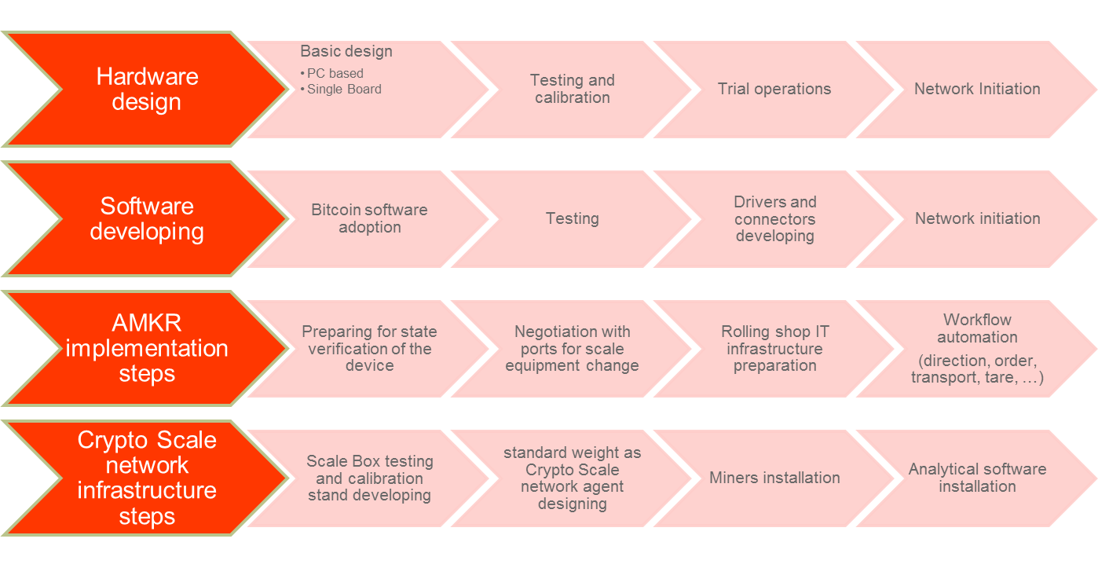
Roadmap

Slide 9
Thanks for you attention!

